Slide 1
Palmer’s International Sales Report Analysis
This report provides a high-level overview of Palmer’s International sales performance for the year 2024.

Slide 2
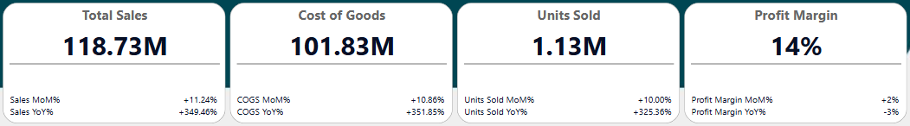
Sales Analysis: Key Performance Indicators
During the 2024 year, Palmer’s International generated a total of ~$118 million in sales, with a cost of goods sold (COGS) of ~$101 million, resulting in a gross profit of ~$17 million and an overall profit margin of 14%. The company sold approximately 1.13 million units.
The Government Sector was the largest revenue generator with with $52.5 million in sales with a profit margin of 22%. In contrast, the Enterprise sector was the least profitable, delivering a -3% profit margin despite contributing the third most in total sales and showing consistent growth throughout the year.
Geographically, Canada was the most profitable country with a profit margin of 14%. Even though the United States had the most total revenue they had the lowest profit margin of 12%. Overall, the KPIs reflect a healthy and scalable business with key opportunities for margin growth, particularly through high-efficiency segment and region optimization.

Slide 3
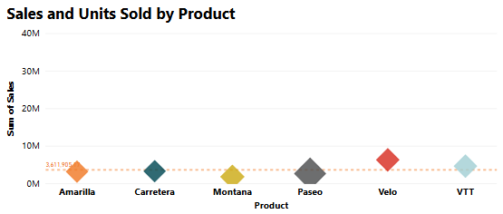
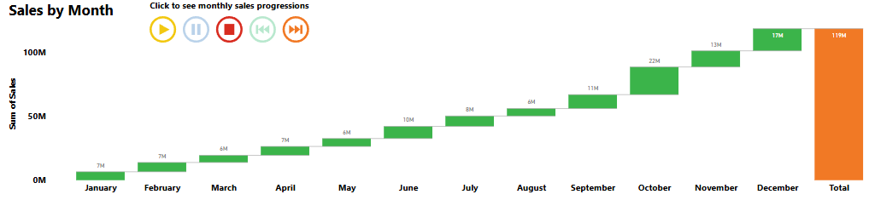
Sales Analysis: Sales by Month
September - December were the best selling months with October being the highest earning month with $21.67 million in sales, suggesting successful seasonal or promotional efforts.
March produced the least amount of sales of ~$5.5m suggesting that there was a lull in demand in Q1. There was a steady increase throughout the year showing opportunity for new campaigns.
The Velo was the highest selling product in October with ~$6.3m total sales and ~30k units sold.
Suggestion: using Q4 promotional strategies to boost Q1 sales. Introduce Q1-specific campaigns or product incentives.

Slide 4
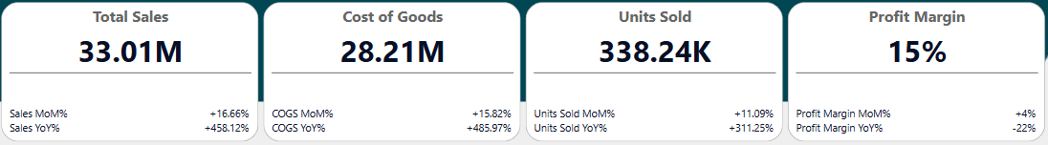
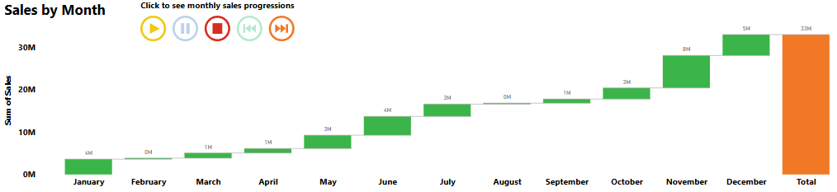
Sales Analysis: Product Analysis
Paseo is your best selling product with $33M in total sales, with a profit margin of 15% and 338K units sold.
Total sales by segment
Government: $14.8m
Small Business: $11.5m
Enterprise: $5.2m
Midmarket: $907k
Channel Partners: $454k
Suggestion: Reassess Enterprise strategy – optimize pricing and cost structure to minimize losses.
Sales by Country
US: $7m
Canada: $7.6m
France: $5.6m
Germany: $5.2m
Mexico: $7.6m
Suggestion: Optimize your discount strategy while expanding Paseo reach into other profitable markets.

Slide 5
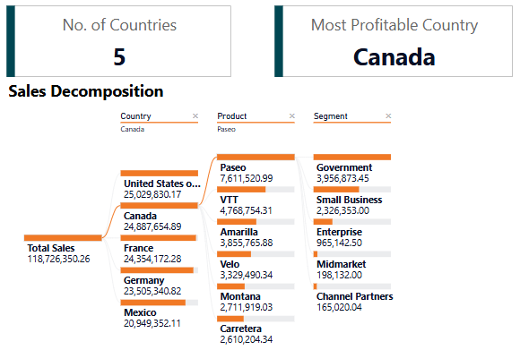
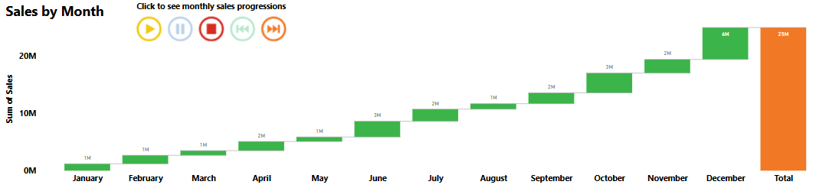
Regional Performance: Country
Canada is your most profitable country with $24.8m in total sales, with a profit margin of 14% and 247.43k units sold (most out of 5 countries).
Canada saw consistent growth in sales throughout the year with 7 months having more than $2m in sales.
Canada received a total of $9m in discounts with Paseo accounting for $3m of the $9m.

Slide 6
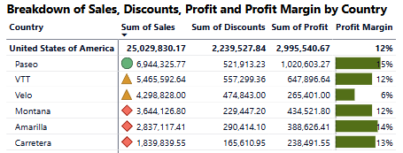
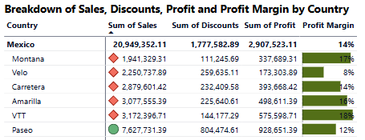
Regional Performance: Country
The United States is your least profitable country with a profit margin of 12% but the US has the highest amount of sales with $25m. In contrast, Mexico has the least amount of total sales with $20.9M.
Insight: Canada leads in both unit sales and profitability. U.S. has volume but low efficiency.
Suggestion: Tighten U.S. discounting and focus on margin optimization.

Slide 7
Final Insights
Palmer’s International closed 2024 with $118M in total revenue, selling 1.13 million units and achieving a 14% profit margin. While overall performance is strong, opportunities remain to improve profitability through optimized segment strategies, more efficient discounting, and expanded use of successful campaigns.
Strategic Recommendations
Enterprise Turnaround: Audit contracts, acquisition costs, and pricing.
Q1 Growth Plan: Introduce early-year promotions, refreshed campaigns in March.
Optimize U.S. Profitability: Reduce discounting, improve margin per unit.
Paseo & Velo Strategy: Broaden product appeal using October's marketing success.
Discount Controls: Implement protections on promotions in high-performing regions like Canada.

